Slide 1
Harmonic Input
ME 357

Slide 2
Objectives
By the end of this section, you should be able to
Read log-scale plot
Use Bode plot to determine magnitude and phase of output signal
Find closed-form steady-state outputs for linear systems with simple harmonic input
Use normalized Bode plot to design systems to operate away from resonance
Understand sensor dynamic range from their Bode plot
Design simple analog LP and HP filters

Slide 3
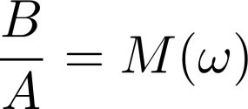
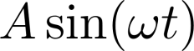
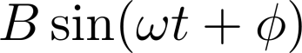
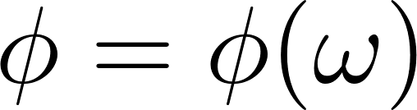
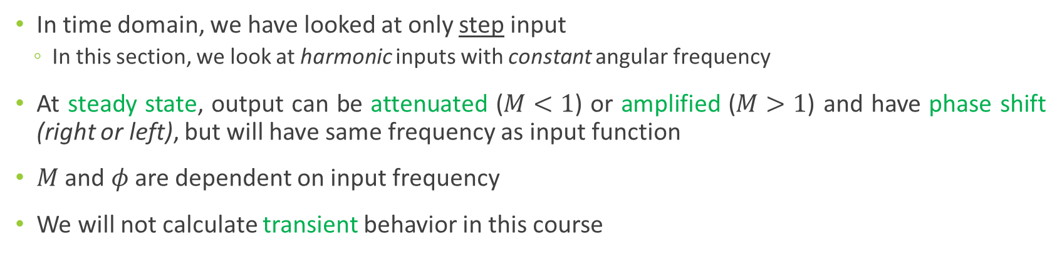
Frequency Domain
In time domain, we have looked at only step input
In this section, we look at harmonic inputs with constant angular frequency
At steady state, output can be attenuated ($M<1$) or amplified ($M>1$) and have phase shift (right or left), but will have same frequency as input function
$M$ and $φ$ are dependent on input frequency
We will not calculate transient behavior in this course
G(s)
(Linear)
Notes:
This is true for linear systems at steady-state
Same with cosine

Slide 4
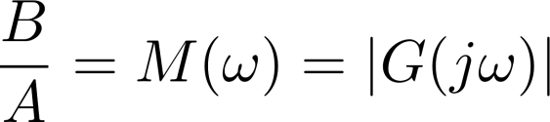
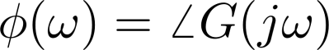
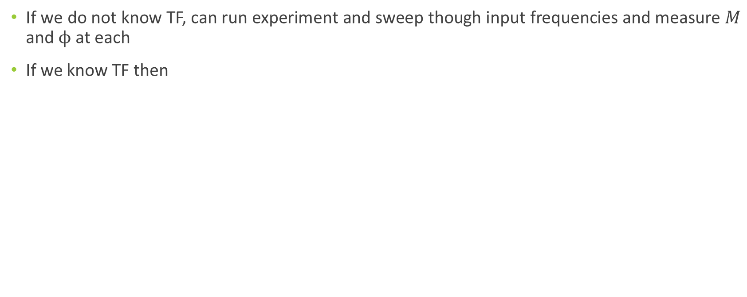
Finding Parameters
If we do not know TF, can run experiment and sweep though input frequencies and measure $M$ and $ϕ$ at each
If we know TF then
Notes:
We will not look at experimental data in this course

Slide 5
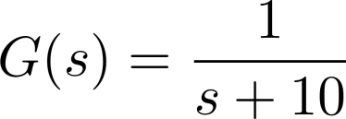
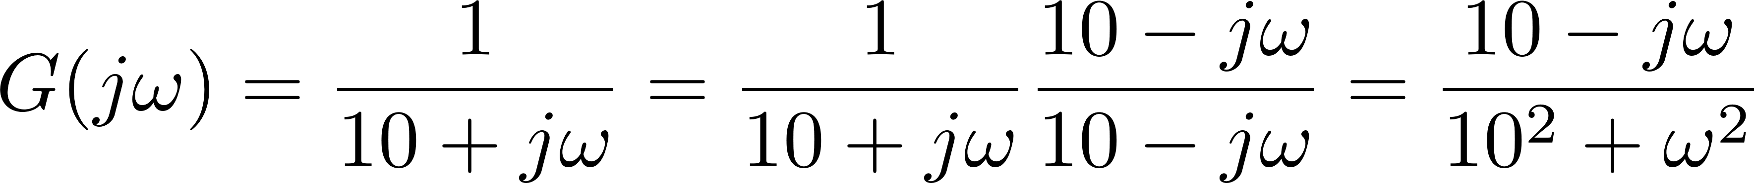
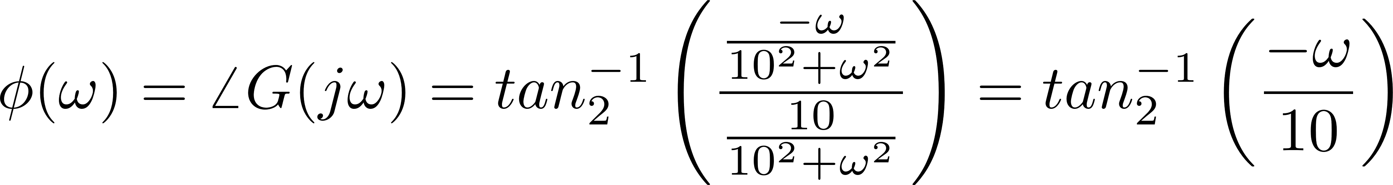
Analytic Example

Slide 6
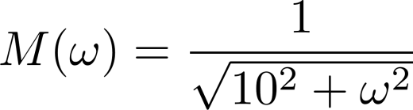
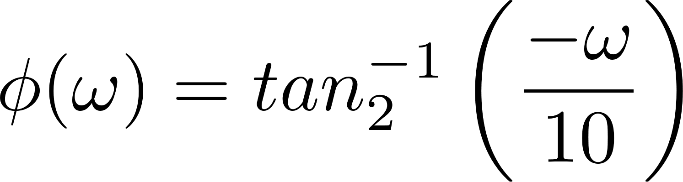

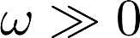
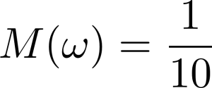
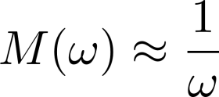
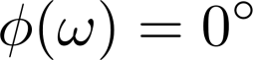
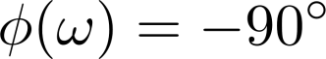
Analytic Example

Slide 7
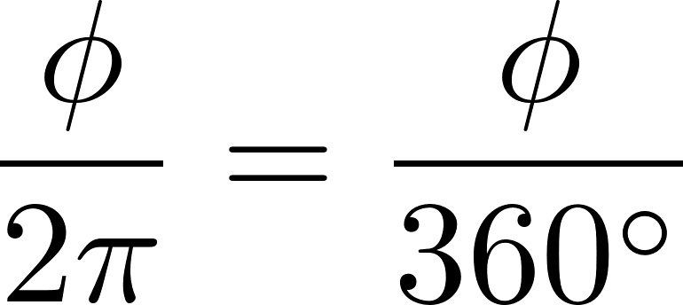
Phase
Phase lead (positive value) or phase lag (negative value) is what fraction of forcing cycle output is offset from input
Examples
When phase is 0⁰, output cycle matches input cycle (in-phase)
When phase is -120⁰, output lags input by a third of a cycle
When phase is -180⁰, output lags half cycle behind input (antiphase)

Slide 8
Bode Diagram
Bode diagram visualizes magnitude and phase shift over range of input frequencies
Matlab plots as log-log and semi-log plots
y-axis in decibels (for amplitude) and degrees (for phase)
x-axis (frequency) in log scale
Spike in amplification indicates resonance or instability at that input frequency(ies)
Usually do not want to operate near spike
May change either input frequency or system parameters to move away from spike
Notes:
it is a plot using the previous definitions of magnitude and phase

Slide 9
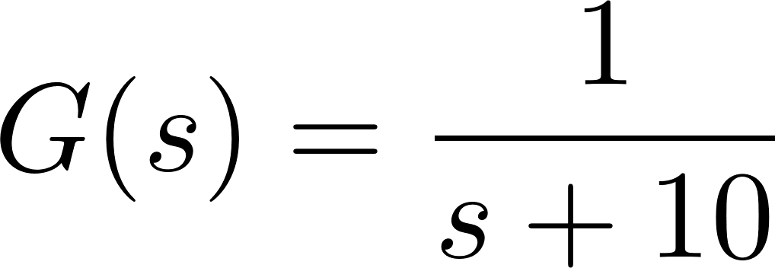
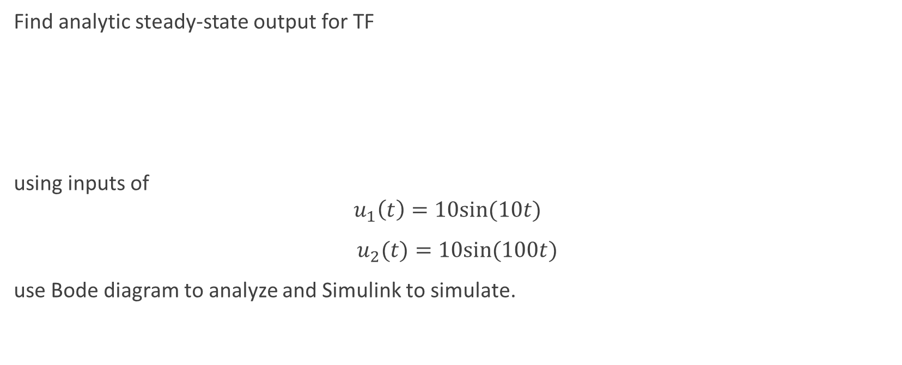
Example 1
Find analytic steady-state output for TF
using inputs of
$$u_{1}\left(t\right)=10sin⁡(10t)$$
$u_{2}(t)=10sin⁡(100t)$
use Bode diagram to analyze and Simulink to simulate.

Slide 10
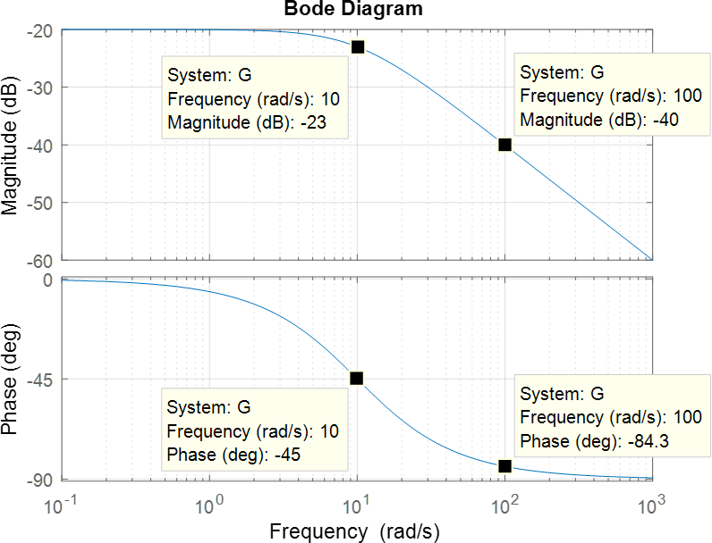
Example 1 Bode Diagram
Notes:
This matches what we found analytically

Slide 11
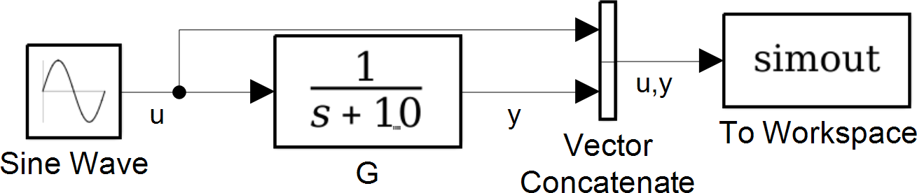
Example 1 Simulink Model

Slide 12
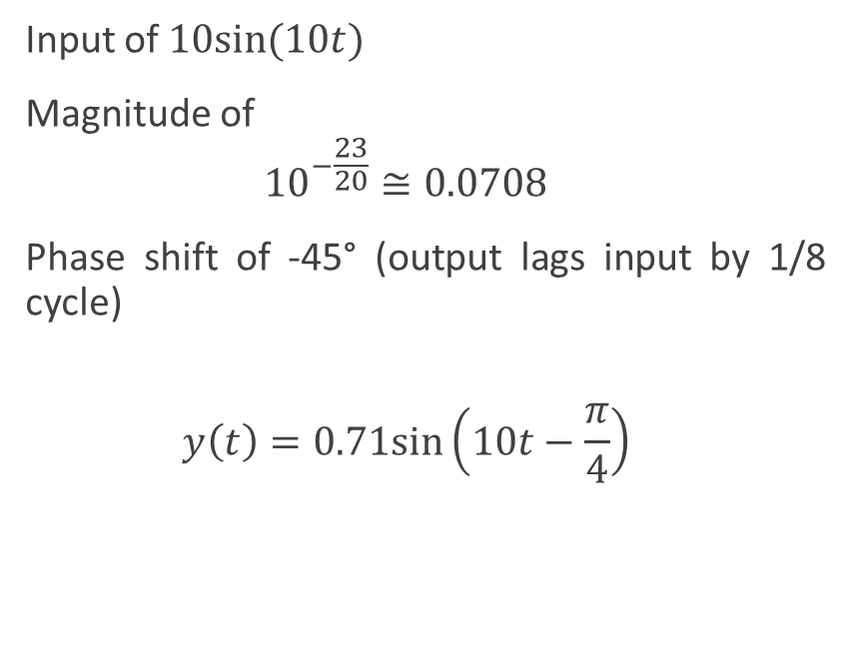
Example 1 Simulation
Input of $10sin⁡(10t)$
Magnitude of
$${10}^{−\frac{23}{20}}≅0.0708$$
Phase shift of -45° (output lags input by 1/8 cycle)
$$y\left(t\right)=0.71sin⁡\left(10t−\frac{π}{4}\right)$$

Slide 13
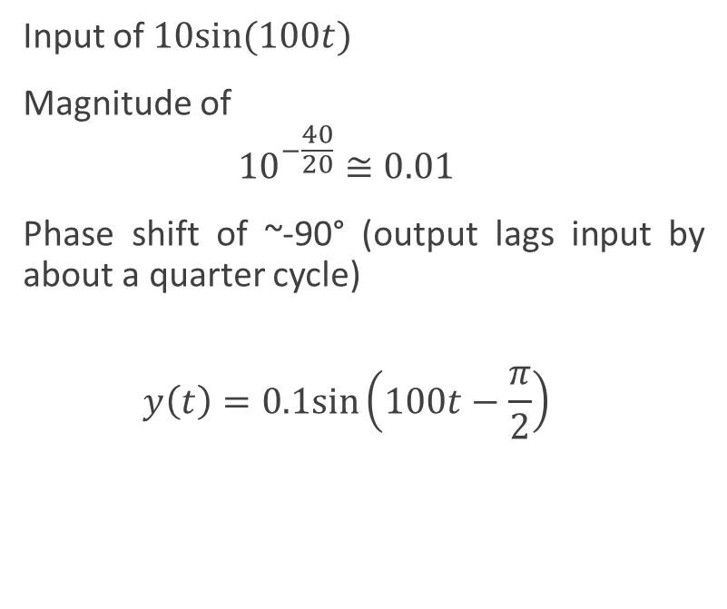
Example 1 Simulation
Input of $10sin⁡(100t)$
Magnitude of
$${10}^{−\frac{40}{20}}≅0.01$$
Phase shift of ~-90° (output lags input by about a quarter cycle)
$$y\left(t\right)=0.1sin⁡\left(100t−\frac{π}{2}\right)$$

Slide 14
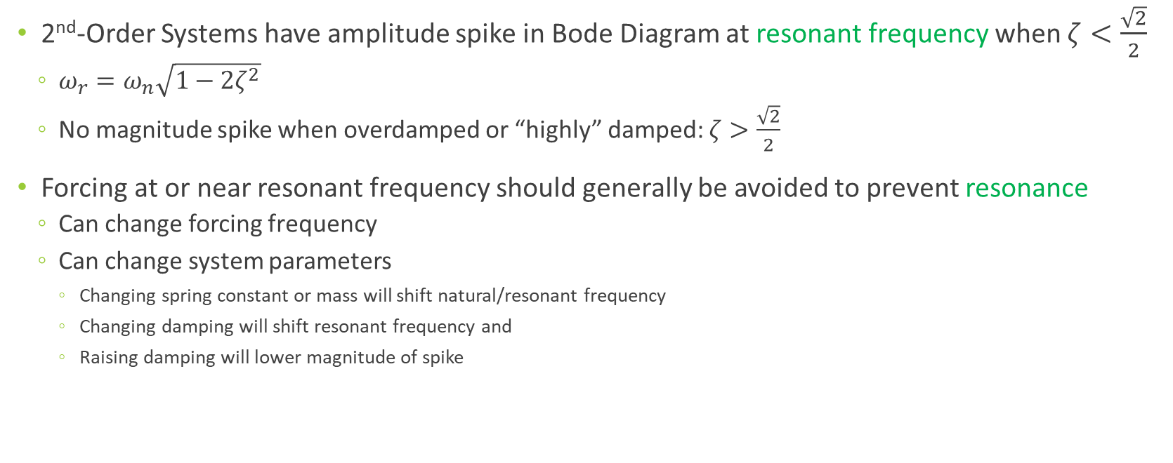
2nd-Order (and Higher) Systems
2nd-Order Systems have amplitude spike in Bode Diagram at resonant frequency when $ζ<\frac{\sqrt{2}}{2}$
$ω_{r}=ω_{n}\sqrt{1−2ζ^{2}}$
No magnitude spike when overdamped or “highly” damped: $ζ>\frac{\sqrt{2}}{2}$
Forcing at or near resonant frequency should generally be avoided to prevent resonance
Can change forcing frequency
Can change system parameters
Changing spring constant or mass will shift natural/resonant frequency
Changing damping will shift resonant frequency and
Raising damping will lower magnitude of spike
Notes:
The resonant frequency is close to the natural frequency (especially for low damping) but always lower

Slide 15
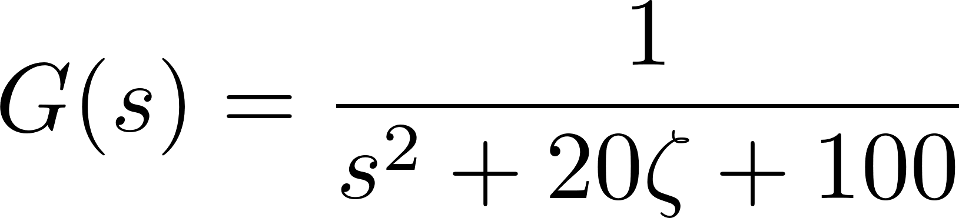
2nd-Order (and Higher) Systems
With increasing damping
Spike peak lowers
Spike shifts left

Slide 16
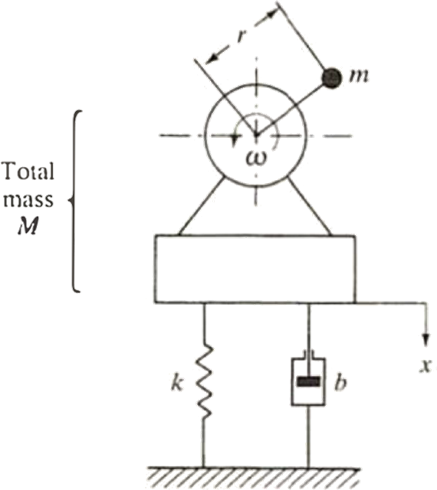
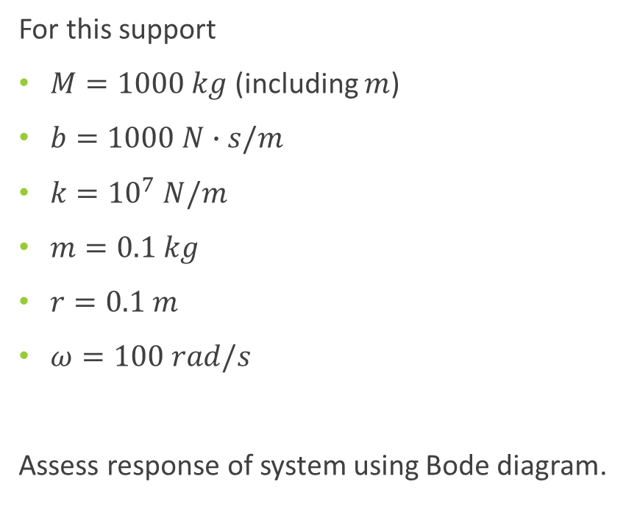
Rotating Machinery Example 2
For this support
$M=1000 kg$(including $m$)
$b=1000 N∙s/m$
$k={10}^{7} N/m$
$m=0.1 kg$
$r=0.1 m$
$ω=100 rad/s$
Assess response of system using Bode diagram.

Slide 17





FBD Example 2
=
Notes:
Accounting for only vertical force of rotating machine

Slide 18
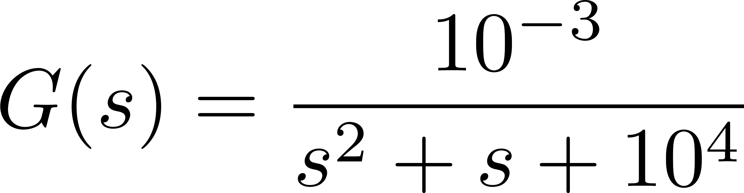
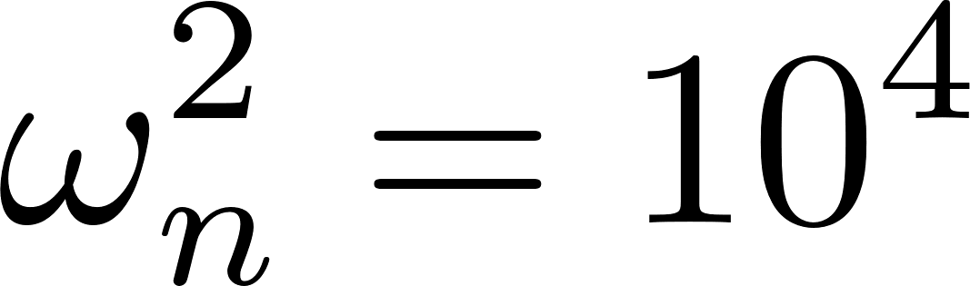


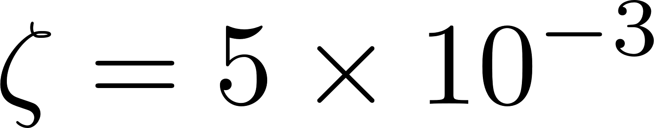
Example 2
Notes:
Very low damping but not zero

Slide 19
Bode Diagram Example 2
Notes:
Damping is very low so wr ~ wn

Slide 20
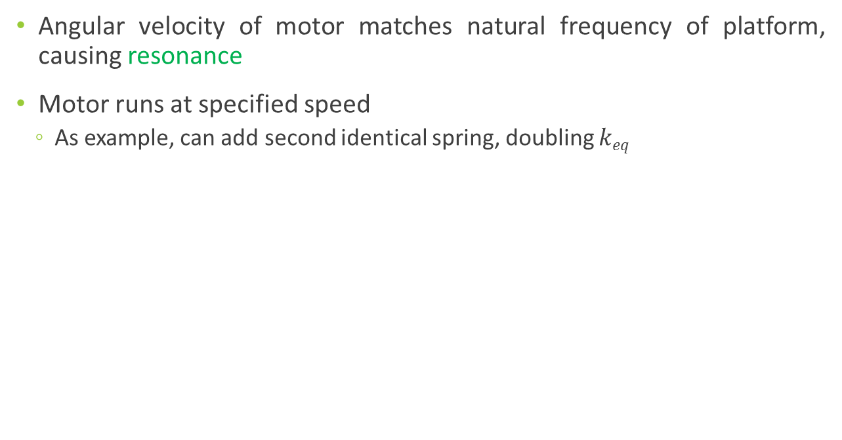
Rotating Machinery Example 2
Angular velocity of motor matches natural frequency of platform, causing resonance
Motor runs at specified speed
As example, can add second identical spring, doubling $keq$

Slide 21
Bode Diagram Example 2

Slide 22
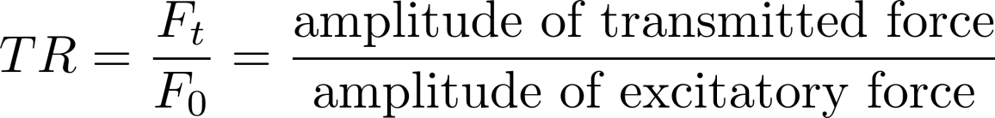
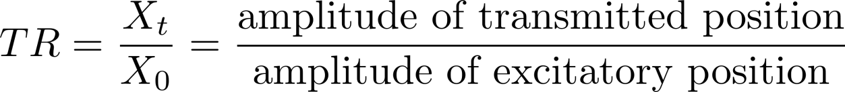
Transmissibility
Ratio of output force or motion to input force or motion (must be like quantities)

Slide 23
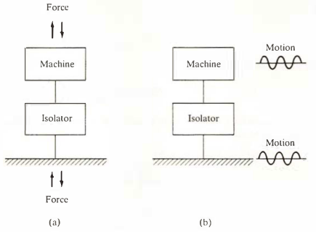
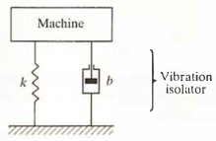
Vibration Isolator
For rotating machinery, may not want it to transmit force into shared support (e.g., shop floor) as it can disrupt other rotating machines
Can put vibration isolator between machine and support to reduce transferred force

Slide 24
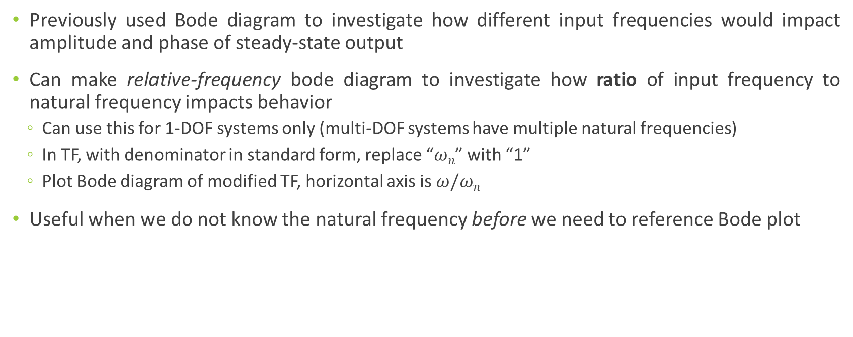
Relative-Frequency Bode Diagram
Previously used Bode diagram to investigate how different input frequencies would impact amplitude and phase of steady-state output
Can make relative-frequency bode diagram to investigate how ratio of input frequency to natural frequency impacts behavior
Can use this for 1-DOF systems only (multi-DOF systems have multiple natural frequencies)
In TF, with denominator in standard form, replace “$ωn$” with “1”
Plot Bode diagram of modified TF, horizontal axis is $ω/ωn$
Useful when we do not know the natural frequency before we need to reference Bode plot

Slide 25
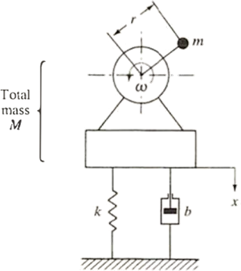
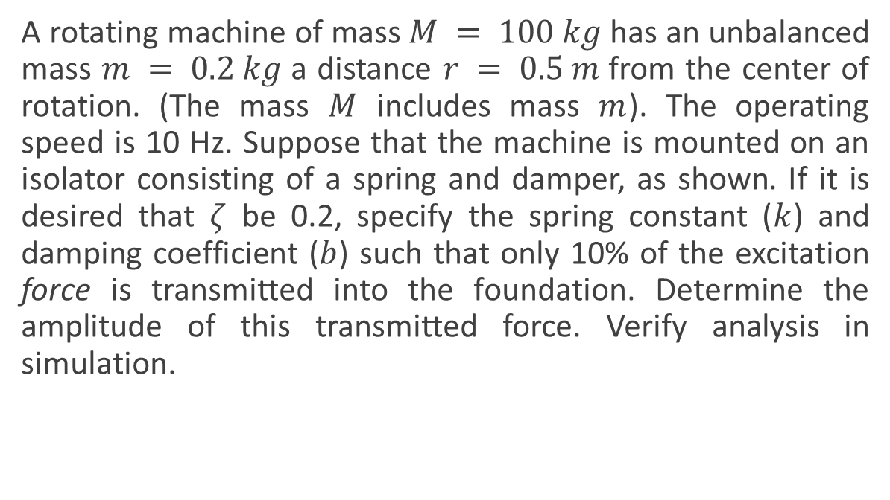
Example 3
A rotating machine of mass $M = 100 kg$has an unbalanced mass $m = 0.2 kg$a distance $r = 0.5 m$from the center of rotation. (The mass $M$ includes mass $m$). The operating speed is 10 Hz. Suppose that the machine is mounted on an isolator consisting of a spring and damper, as shown. If it is desired that $ζ$ be 0.2, specify the spring constant ($k$) and damping coefficient ($b$) such that only 10% of the excitation force is transmitted into the foundation. Determine the amplitude of this transmitted force. Verify analysis in simulation.
Notes:
Using RF bode plot because we do not have both wn and z beforehand

Slide 26


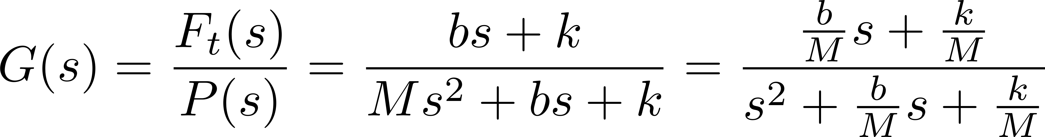
FBD Example 3
=
=
Notes:
I assume ft is positive up, could assume the opposite with little difference in results
Used Mathematica for the algebra

Slide 27
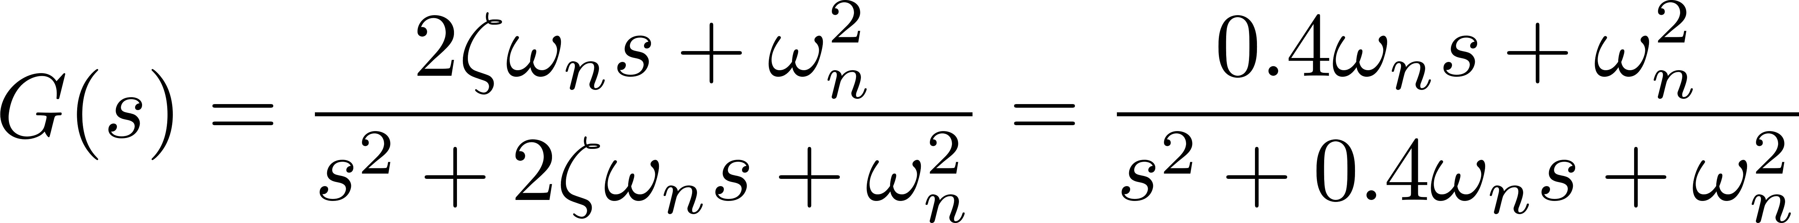
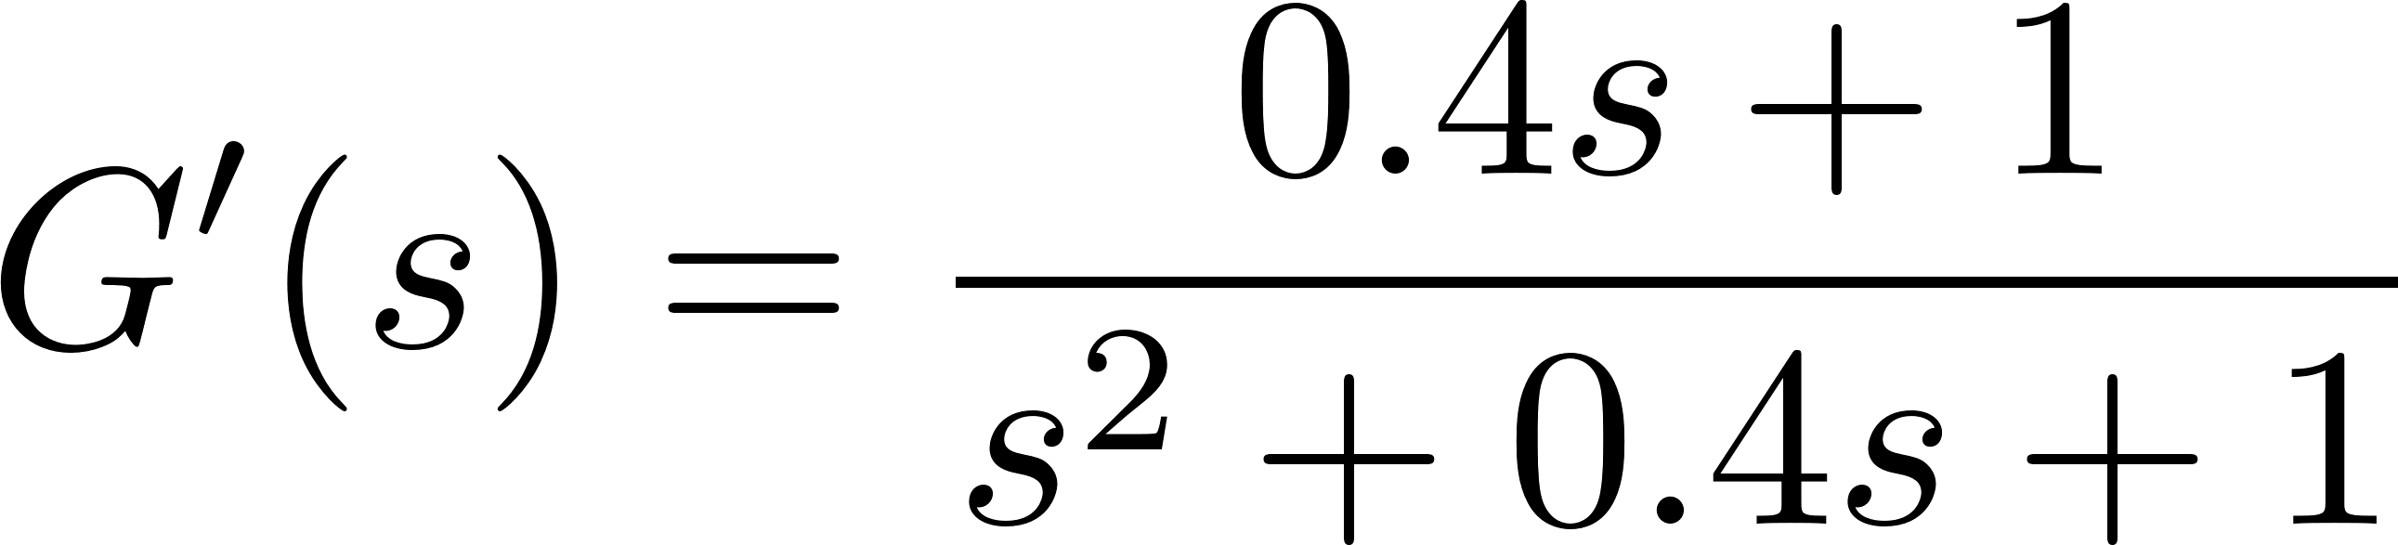
Example 3
Notes:
1: in standard form
2: let zeta = 0.2
3: set wn to 1 for RF Bode diagram

Slide 28


Example 3
Notes:
1: in standard form
2: let zeta = 0.2
3: set wn to 1 for RF Bode diagram

Slide 29

RF Bode Diagram Example 3
Notes:
Fairly low damping so wr~wn

Slide 30
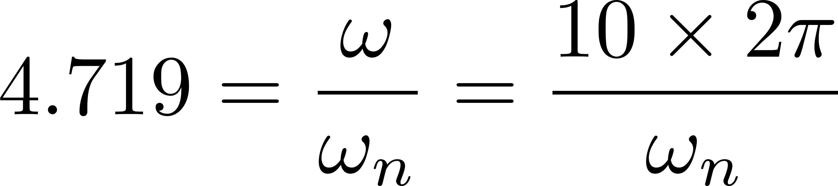

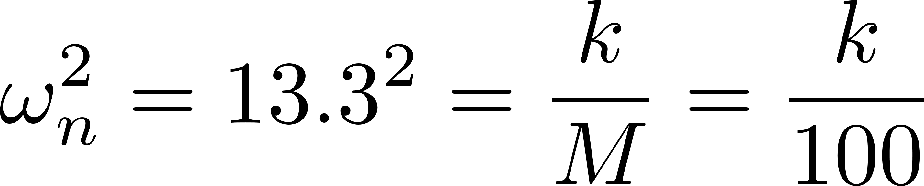
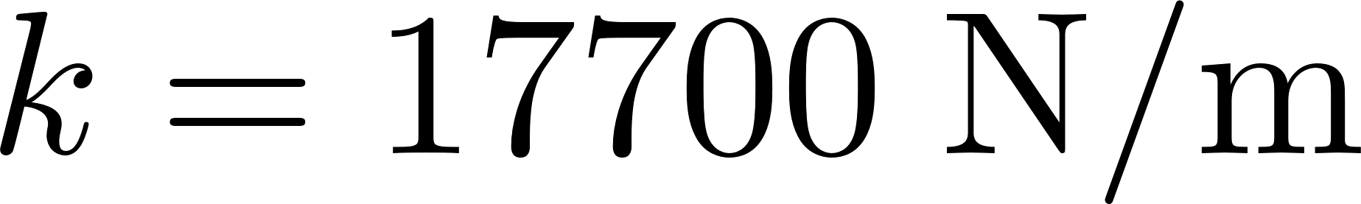
Example 3
Notes:
1: in standard form
2: let zeta = 0.2
3: set wn to 1 for RF Bode diagram

Slide 31
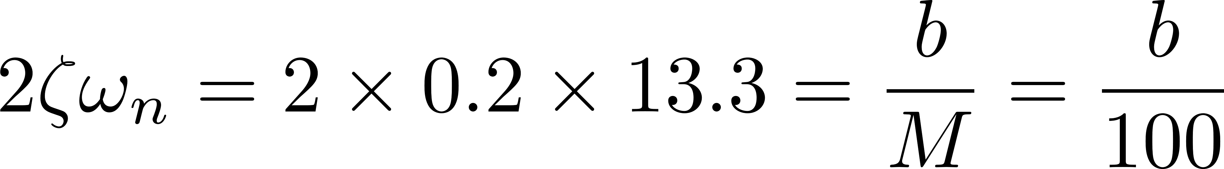
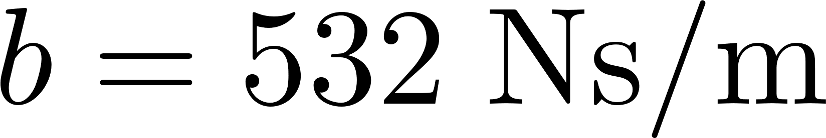
Example 3
Notes:
1: in standard form
2: let zeta = 0.2
3: set wn to 1 for RF Bode diagram

Slide 32
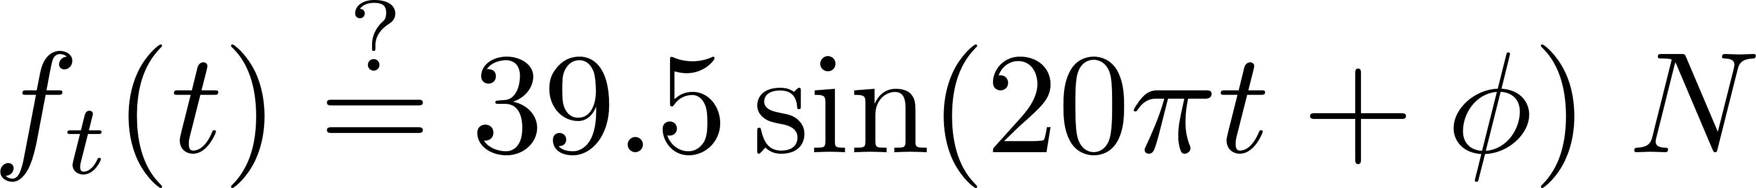
Example 3
Notes:
Output should be 10% of input by design

Slide 33
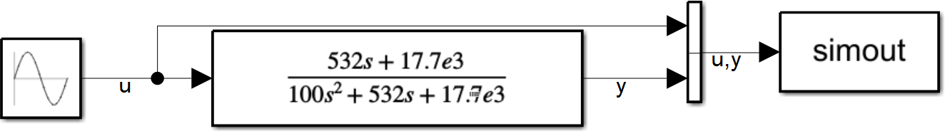
Simulink Model Example 3

Slide 34

Simulation Example 3
Transient response

Slide 35


Example 4 Seismograph
The displacement of mass m relative to inertial space is denoted by x, the displacement of the case relative to inertial space by y. The displacement y is the input to system and, in the case of earthquakes, is approximately sinusoidal, or $y(t) = Ysinωt$. An earthquake has a frequency typically in the range of 1-10Hz. In the seismograph, we measure relative displacement between x and y. Choose $m$, $k$ and $b$ such that the seismograph can measure Y accurately (at steady state).

Slide 36


Example 4 RF Bode Diagram

Slide 37



Example 4 RF Bode Diagram

Slide 38


Example 6
A machine of mass m mounted on a vibration isolator in which spring $k1$ is the load-carrying spring and viscous damper $b2$is in series with spring $k2$.
Determine the force transmissibility when the machine is subjected to a sinusoidal excitation force
$$p\left(t\right)=Psin(ωt).$$
Let
$$m = 20 kg, k1 = 4 kN/m, k2 = 3 kN/m, b2 = 345 \frac{N∙s}{m}, P = 600N, ω = 40 rad/s$$

Slide 39

Example 6

Slide 40

Example 6

Slide 41
Multi-DOF Systems
May have multiple natural frequencies (if 4th-order or higher)
Natural frequencies found by taking magnitudes of eigenvalues of A or poles of TF
Peaks on Bode diagram(s) may be near natural frequencies
May be easier to start in SS and convert to TF

Slide 42


Multi DOF Systems Example 5
k₁ = 20 N/m; k₂ = 30 N/m;
b₁ = 5 N-s/m
m₁ = 10 kg; m₂ = 15 kg
Is system stable or unstable?
Find natural frequencies of system
Find exact steady-state response of positions when $u(t)=2000sin⁡(5t) N$

Slide 43




Multi DOF Systems Example 5
A
B
C
D
Notes:
Similar to 9.2

Slide 44

Multi DOF Systems Example 5
Notes:
Using ss2tf

Slide 45


Multi DOF Systems Example 5
Notes:
Using ss2tf

Slide 46

Multi DOF Systems Example 5

Slide 47

Multi DOF Systems Example 5

Slide 48




Multi DOF Systems Example 5
Notes:
When there is a single input

Slide 49

Multi DOF Systems Example 5

Slide 50
Multi DOF Systems Example 5
Transient response

Slide 51
Multi DOF Systems Example 5

Slide 52
Sensors & Filters

Slide 53
Sensors
Convert measurement of one type into voltage reading
E.g., thermocouple measure temperature, accelerometer measures acceleration, ultrasonic sensor measures position
Sensors themselves are TFs
Convert input into voltage output
May be 1st, 2nd or other order
Can introduce lag and amplification
Takes time for thermocouple to absorb/dissipate heat
Accelerometer has to physically vibrate and overcome inertia
Sensors in system give you observables as discussed in SS modeling
These are quantities we can directly measure in real-time to control system (C matrix)
Notes:
Not universally true voltage output but good enough for this class
A matrix described physics of the system, C describes what we can actually measure

Slide 54
Sensor Range
Ideal sensor
Sensitive to measured property only
Does not influence measured property
Calibration
Need to know how voltage reading corresponds to value of measured quantity
Take several measurements at known quantities to develop linear relation
Sensors can have dynamic error due to rapid changes in measured property
Frequency range where magnitude and phase constant on Bode plot minimizes this error
Operate sensor in this range for known and constant amplification and phase difference with respect to actual signal
Notes:
e.g., measure thermocouple in boiling water (100C) and ice water (0C)
e.g. accels. are sensitive to temperature
mass of accel. can change natural freqs. of beam it measures
Would not have to be linear

Slide 55


Sensor Range Example
For this sensor (e.g. input is force, output is voltage) sensing range is $ω≪0.1$rad/sec. Below this frequency our output magnitude constant (about 8% of the input) and in phase. This sensor is good for low frequency applications.

Slide 56


Measurement/Sensor Range Example
For this sensor, sensing range is about $2e3<ω<1e4$rad/sec. Within this range output magnitude constant and phase shift is small. This sensor is good for medium frequency applications.

Slide 57

Filtering
Real signals contain undesirable noise
Signals not one pure harmonic: contain number of frequencies
E.g., 60 Hz line noise, loose connections add to signal
If noise occurs at frequencies outside what we want to measure, it can be filtered out
Typically choose a cutoff frequency (frequency when magnitude is$\sqrt{2}/2$)
Filter will have rolloff
Types of filters
Low-pass
High-pass
Band-pass
Notch
May introduce lag into output signal
Notes:
How do we know what freqs. we want to measure?

Slide 58


Passive LP Filter Example
Create simple 1st-order low-pass filter with 5 Hz cutoff
Simulate passing input signal of $u\left(t\right)=5\sin\left(0.5t\right)+0.6\sin\left(100t\right)$ through filter and observing output
How could this filter be constructed?
Notes:
cutoff frequency is reciprocal of time constant in 1st-order

Slide 59


LP Filter Example Bode Plot
Notes:
Note cutoff freq.

Slide 60

LP Filter Example Output

Slide 61





LP Filter Example Design
Desired TF
TF of circuit
Pick $R$ and $C$ such that
Notes:
would pick C first as it is more limited in available choices. May not get exact value for cutoff with off-the-shelf parts

Slide 62


Passive HP Filter Example
Create simple 1st-order high-pass filter with 5 Hz cutoff
Simulate passing input signal of $u\left(t\right)=5\sin\left(0.5t\right)+0.6\sin\left(100t\right)$ through filter and observing output
How could this filter be constructed?
Notes:
cutoff frequency is reciprocal of time constant in 1st-order system

Slide 63


HP Filter Example Bode Plot
Notes:
Note cutoff freq.

Slide 64

HP Filter Example Output
Notes:
High frequency remains

Slide 65



HP Filter Example Design
Desired TF
TF of circuit
Pick $R$ and $C$ such that
Notes:
would pick C first as it is more limited in available choices. May not get exact value for cutoff with off-the-shelf parts

Slide 66


Higher-Order Filter Example
Create 2nd-order LP filter with 5 Hz cutoff
Simulate passing input signal of $u\left(t\right)=5\sin\left(0.5t\right)+0.6\sin\left(100t\right)$ through this filter and the 1st-order version and observing output
Compare also to 3rd-order filter
How could these filters be constructed?
Notes:
How can we make the roll-off tighter?
cutoff frequency is reciprocal of time constant in 1st-order system

Slide 67
Higher-Order Filter
Notes:
Attenuates high frequency signals more harshly
Phase lag is introduced more

Slide 68

Construction
Cascading 1st-order filters
Active filters
Use op-amp(s) to improve roll off and reduce lag
Can simplify construction and be adjustable
Require external power for op-amps
https://www.electronics-tutorials.ws/filter/filter_2.html

Slide 69


Active Filters

Slide 70
End Unit 2
System Analysis

